Slide 1





TASK ROULETTE
By; Balmonte, Angel
Herbito, Rizaan

Slide 2







Project Objectives
To help indecisive users with deciding which tasks to do first
Allow users to set deadlines and track progress
For them to finish it slowly but surely so that their work won’t pile up
The project aims to improve task completion, reduce the stress of decision-making, and make prioritizing tasks more fun and effortless.
Notes:
The goal of this project is to create a to-do shuffler that helps users who struggle with deciding what to do first by allowing the program to choose for them, also for them to finish it slowly but surely so that their work won’t be piled up . The progran will let users input their tasks and then shuffle them to determine which one to tackle first. Overall, the project aims to improve task completion, reduce the stress of decision-making, and make prioritizing tasks more fun and effortless.

Slide 3





FEATURES
Add, edit and delete task and due date
Oraganizes the tasks under a specific category (maximum of 5 categories)
Shuffles the tasks
Crosses out the finished tasks and marks the task red if overdue
Displays how many days a task is overdue
Organizes the tasks in a calendar
Progress tracker

Slide 4




METHODOLOGY
PROJECT OVERVIEW
To-do Roulette is a task manger that helps users organize, track and choose tasks.
Main Sections:
Categories
Calendar
Progress tracking
The categories section was implemented first as it served as thee backbone since all tasks and deadlines are stored here

Slide 5
METHODOLOGY
CORE FEATURES
Calendar:
Task Completion System
-Tasks can be marked as done
-Completed tasks are crossed out
-Done tasks are excluded from the roulette
Overdue Task Detection
-If a task is overdue and not yet completed:
it is displayed in red
the number of days overdue is shown
-Completed tasks are crossed out
-Done tasks are excluded from the roulette
Task Category Section
-Tasks are grouped into categories
-Implemented using dictionaries
-Each category stores its own list of tasks
Task Management
-Users can:
Add tasks with deadlines
Edit task name and deadline
Delete tasks
Progress
- Displays the finished tasks

Slide 6
METHODOLOGY
TECHNOLOGIES & SYSTEM INTERACTION & DESIGN
Technologies Used
-Python
-datetime ( handles deadlines )
-random ( task selection )
-Flask for routing and backend
-HTML for interface design
Key Design Decisions
-Calendar for better deadline visualization
Ethical Considerations
-No personal data collected
-Focused only on productivity
System Interaction
-User inputs data through the interface
-The backend processes and stores the data
-The system updates and displays results

Slide 7


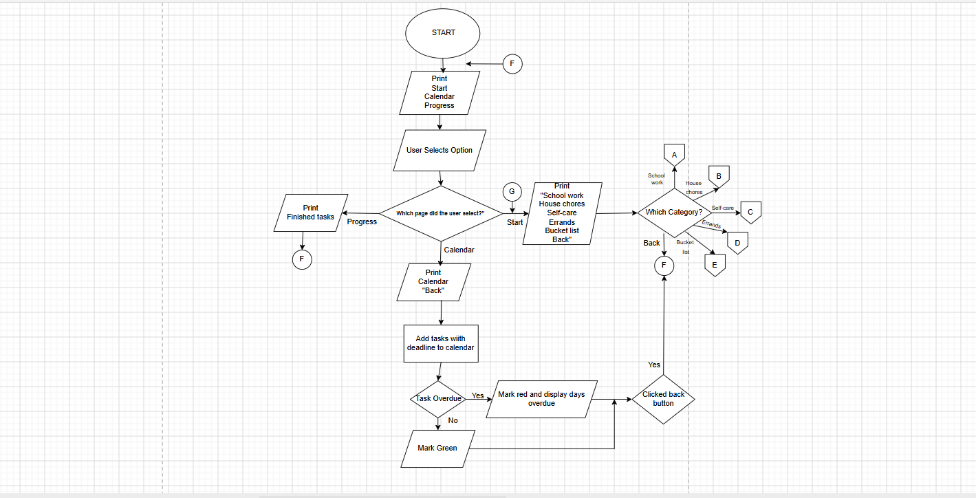

PROCESS FLOW

Slide 8

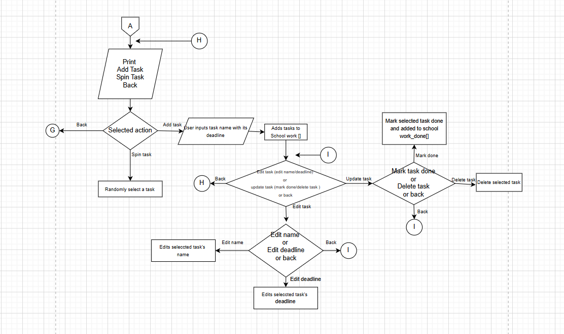
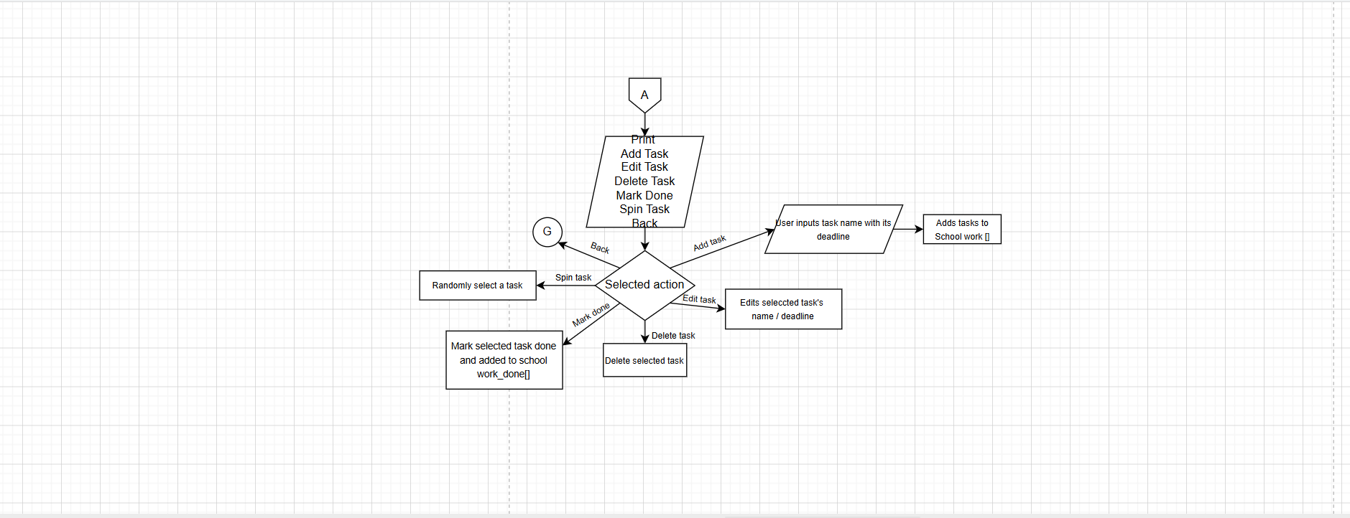


PROCESS FLOW

Slide 9


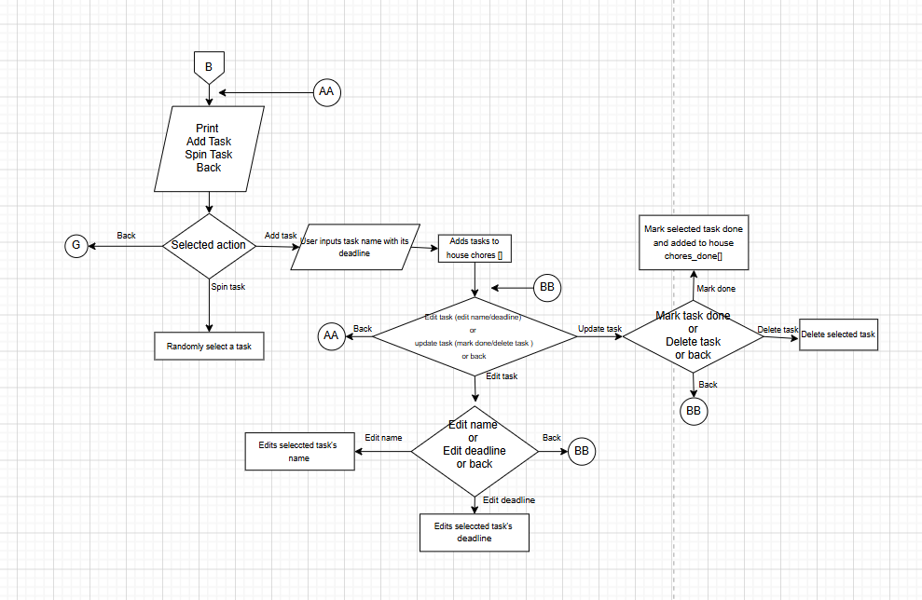
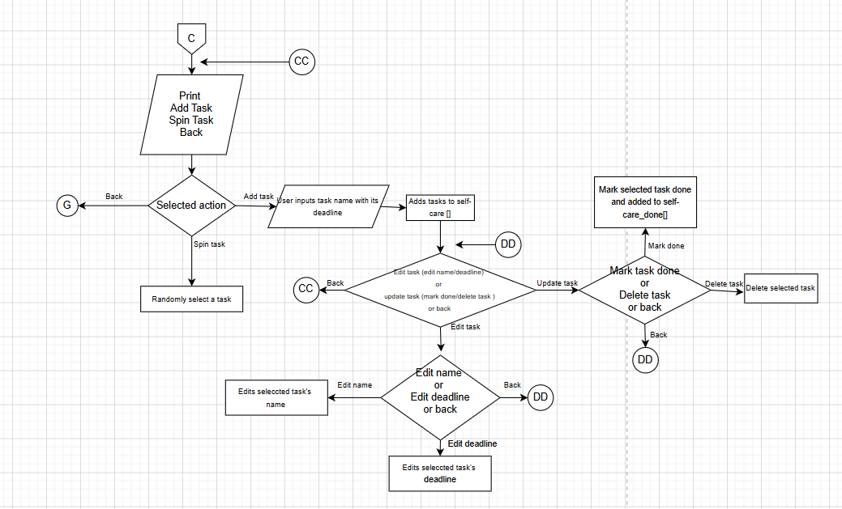

PROCESS FLOW

Slide 10
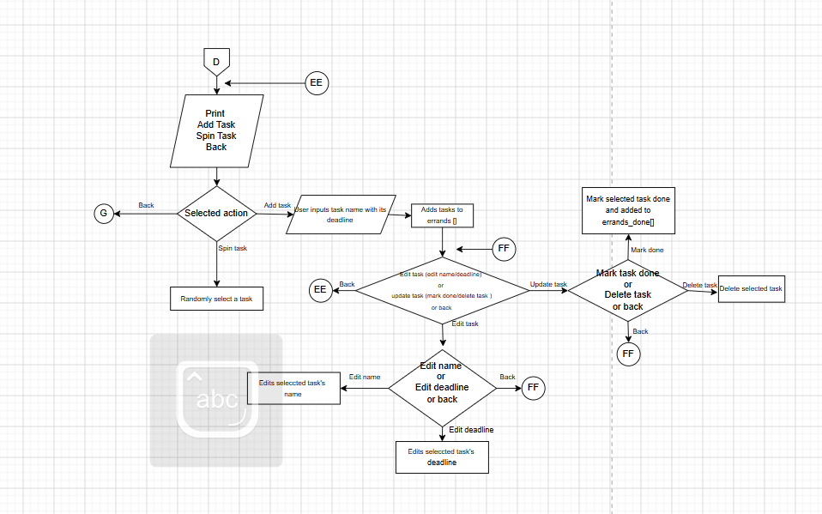
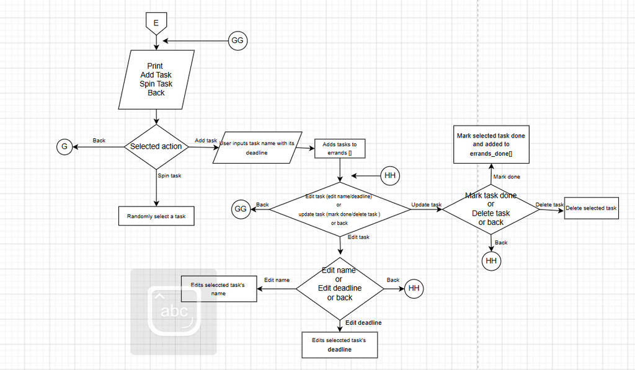
PROCESS FLOW

Slide 11



Thank
You

